Slide 1
Final Project
Dalton Kirk

Slide 2
My Project
Mobile Games made in Unity
Prototypes
One polished game
Portfolio
Art is not being focused on in this project
Improve/showcase skills (code & design)

Slide 3
Initial Research
App annual revenue - $70 billion by 2017 (Paolo Roma, Daniele Ragaglia, 2016)
Games – most popular cateogry in Apple Store (https://www.statista.com/statistics/270291/popular-categories-in-the-app-store/)

Slide 4
Casual Game, familiar yet different
Easy for anyone to understand
Clear goals
USP
Well known theme
Game concepts borrow familiar content and themes from life
Trefry, G (2010) Casual Game Design

Slide 5
The Concept
Restaurant
Matches make meals
Serve the customers whilst matching (spinning plates)
Manage stock
Buy better restaurants
Punishment for matching more than 3 experiement

Slide 6
Current State of the Game – Management Scene

Slide 7
Current State of the Game – Matching Scene

Slide 8
Current State of the Game – Reputation System
Customers leave ratings when served
Average rating effects reputation when you close
Reputation effects number of customers

Slide 9
Issues Faced
How matches are detected
Spent a lot of time changing the system

Slide 10
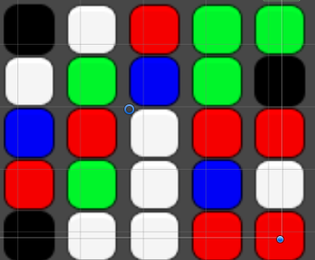
1st Match Detection - List
List = B,W,R,G,G
How to get tiles to fall correctly
Matches over multiple rows

Slide 11
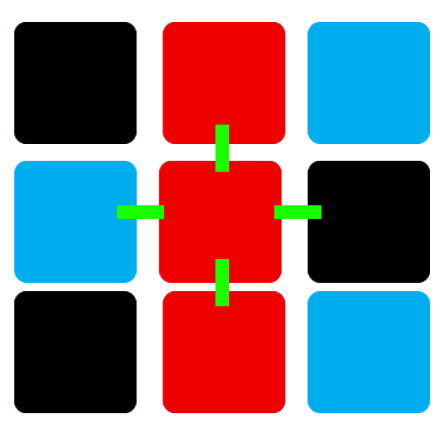
2nd Match Detection - Colliders
Physics + Gravity
Feelers
Can't get more than 3
Not reliable

Slide 12
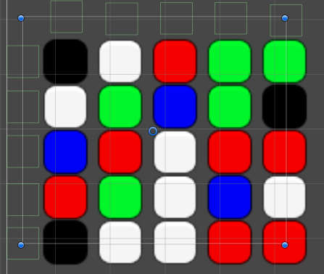
Current Match Detection – My Own Raycasts
Raycasts not reliable
Colliders that pass over tiles
Add tiles to list for the row/column
Check through list for matches

Slide 13
What’s Next?
Finish reputation system
Add second restaurant
Get play testers
Add or change features
Polish

Slide 14
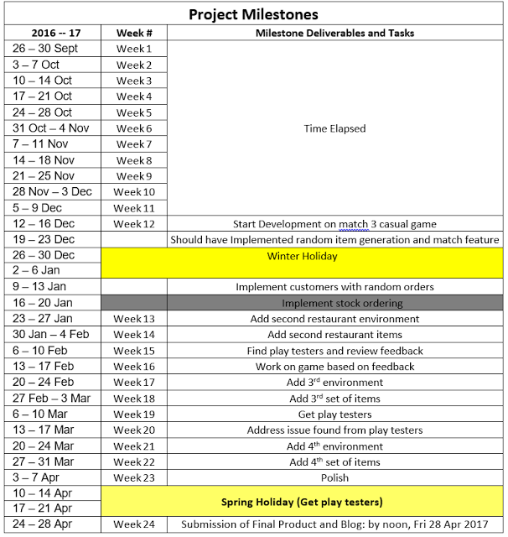
Project Milestones – Old

Slide 15
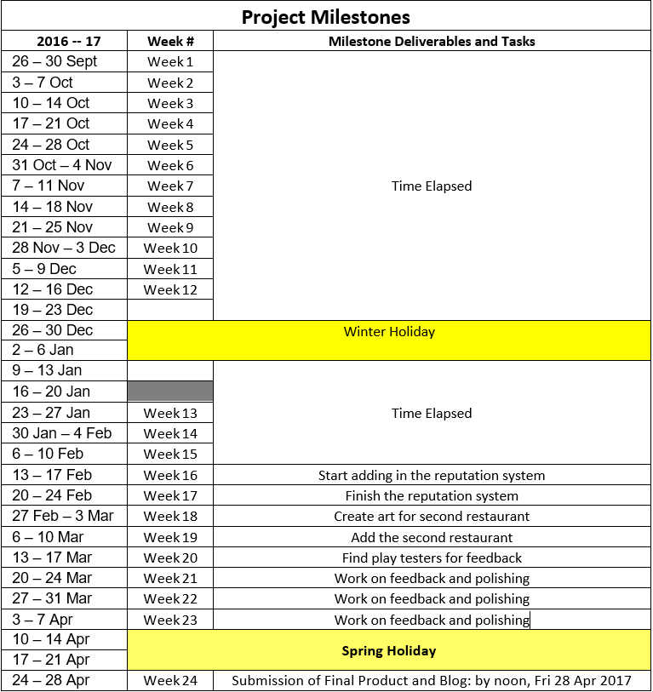
Project Milestones – New

Slide 16
Testing on a mobile

Slide 17
Questions?

